Slide 1
Weekly Update - 5.1

Slide 2
Paper Covered
Castanhel, Gabriel R., et al. "Taking a Peek: An Evaluation of Anomaly Detection Using System calls for Containers." 2021 IEEE Symposium on Computers and Communications (ISCC). IEEE, 2021.
Sarkale, Vivek Vijay, Paul Rad, and Wonjun Lee. "Secure cloud container: Runtime behavior monitoring using most privileged container (mpc)." 2017 IEEE 4th International Conference on Cyber Security and Cloud Computing (CSCloud). IEEE, 2017.
Cavalcanti, Marcos, Pedro Inacio, and Mario Freire. "Performance Evaluation of Container-Level Anomaly-Based Intrusion Detection Systems for Multi-Tenant Applications Using Machine Learning Algorithms." The 16th International Conference on Availability, Reliability and Security. 2021.

Slide 3
Threat Model of Existing tool: Seccomp(In scope)
Restrict the system call to different resources through 3 types of profiles.
Profiles are -
Audit: Logs all system calls by a container for inspection in syslog file.
Violation: Show error message to user space for all kinds of system calls.(i.e. System call failed)
Fine-grained: Customize system calls to allow some of the system calls.
System calls blocked by default seccomp profile:
Seccomp security profiles for Docker | Docker Documentation
Vulnerabilities mitigated by seccomp profiles:
Docker security non-events | Docker Documentation (xy2401.com)

Slide 4
Some Assumptions of Seccomp
Only 4 system calls are allowed: read, write, _exit, sigreturn(Before the invention of fine-grained profile).
The seccomp status is set per-thread, requiring each thread in a process to configure seccomp independently.
Not everyone can configure seccomp profile. The caller must have the CAP_SYS_ADMIN capability.
Assigned profile can’t be deleted without root permission

Slide 5
Threat Model of Existing tool: Seccomp BPF
Can Control which system calls are permitted to the caller.
Control based on system call number and arguments.
prctl(PR_SET_SECCOMP, SECCOMP_MODE_FILTER, &prog) system call can be used to provide system call filtering program in kernel
In later version of Linux, seccomp() system call is deployed to replace the prctl(...) system call.
BPF programs executed in a Virtual Machine implemented in the kernel.
BPF Program must finish with a Return.
Only branch-forward instructions
No loops
Instruction sets: Conditional JMP, JMP, LOAD, Store, Return

Slide 6
Some Assumptions of Seccomp BPF
The seccomp status is set per-thread, requiring each thread in a process to configure seccomp independently.
Not everyone can configure seccomp profile. The caller must have the CAP_SYS_ADMIN capability, or the calling thread must have the no_new_priv bit set.
Installed Filter can’t be removed.

Slide 7
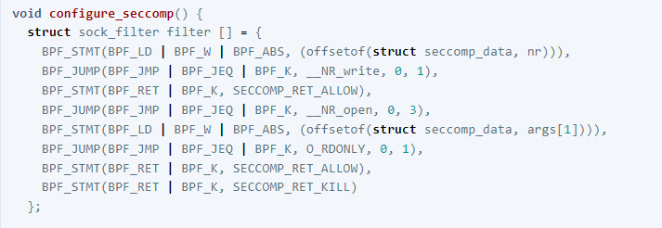

BPF Example

Slide 8
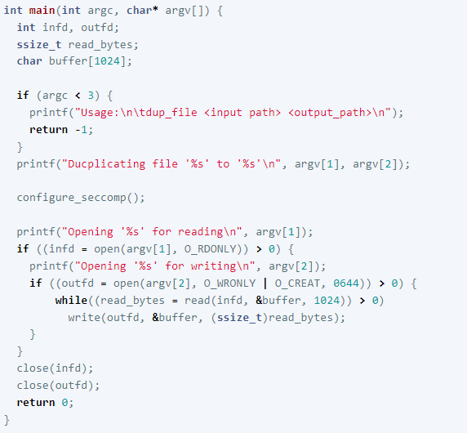
BPF Example contd…

Slide 9
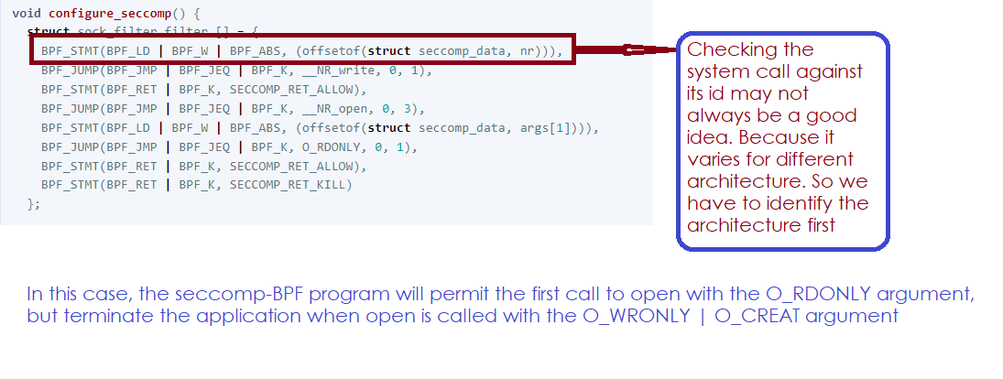
BPF Example contd…

Slide 10
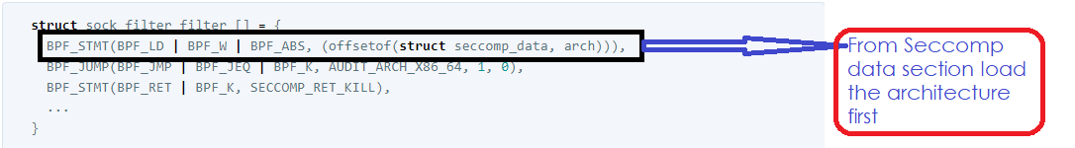
BPF Example contd…

Slide 11
Apparmor(Out of Scope)
Up until now, two CVEs relating to apparmor have not yet been solved -
CVE-2017-6507: Bug #1668892 “CVE-2017-6507: apparmor service restarts and packa...” : Bugs : apparmor package : Ubuntu (launchpad.net)
CVE-2016-1585: Bug #1597017 “mount rules grant excessive permissions” : Bugs : AppArmor (launchpad.net)

Slide 12
Current Roadblocker
We were able to gather very little knowledge about the unsolved CVEs of apparmor. Two loopholes of Seccomp BPF were found during our study about seccomp - One being no common technique to check syscall for all system architecture and the other being the system call with pointer argument ignored by seccomp BPF to avoid TOCTTOU attack.

Slide 13
References
https://cloudsecdocs.com/container_security/theory/threats/k8s_threat_model/
CVE-2019-7303 : A vulnerability in the seccomp filters of Canonical snapd before version 2.37.4 allows a strict mode snap to insert char (cvedetails.com)
snap - seccomp BBlacklist for TIOCSTI can be Circumvented - Linux dos Exploit (exploit-db.com)
Docker security non-events | Docker Documentation (xy2401.com)
Seccomp security profiles for Docker | Docker Documentation
Security: Linux kernel minor "seccomp" vulnerability (scarybeastsecurity.blogspot.com)
Vulnerability Linux kernel Tracing Process Seccomp Syscall Modify | Vigil@nce (vigilance.fr)
CVE-2019-7303 | Ubuntu
Bug #1812973 “snap: seccomp blacklist for TIOCSTI can be circumv...” : Bugs : snapd (launchpad.net)
CESA-2009-004 - rev 1 (beasts.org)
https://lwn.net/Articles/822256/?fbclid=IwAR1NahCTEPq9uuFvU2HnSCHzt8bSBQW9uwpPdwQI_KWnJ1kgHz5LTK8uWyY
https://cloudsecdocs.com/container_security/theory/threats/k8s_threat_model/
Bug #1668892 “CVE-2017-6507: apparmor service restarts and packa...” : Bugs : apparmor package : Ubuntu (launchpad.net)
<sys/stat.h> (opengroup.org)
Seccomp BPF (SECure COMPuting with filters) — The Linux Kernel documentation
(162) Using Seccomp to Limit the Kernel Attack Surface - Michael Kerrisk, man7.org Training and Consulting - YouTube
Seccomp and Seccomp-BPF | Alex Chapman’s Blog (ajxchapman.github.io)

